Slide 1
Welcome to NTU
Enter

Slide 2
Objective
To make online lessons more engaging
Target audience: Primary/ secondary school students (?)

Slide 3
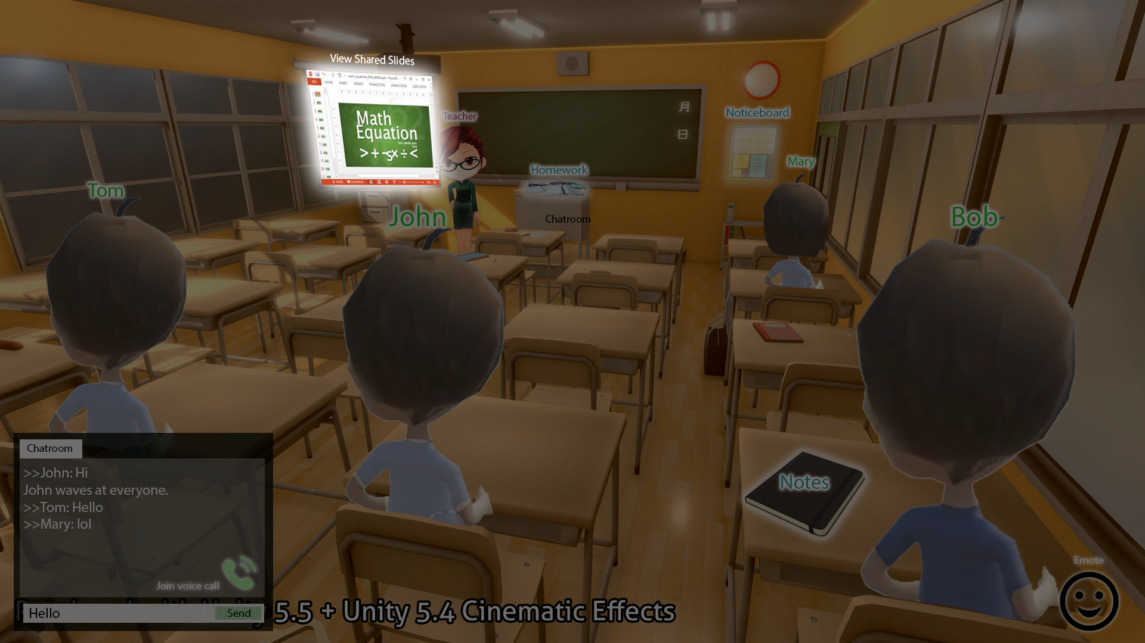
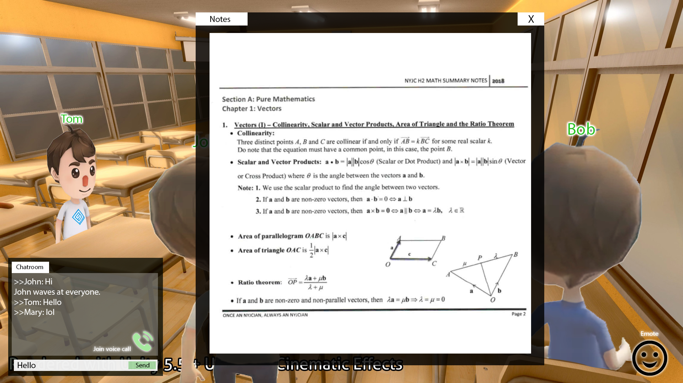
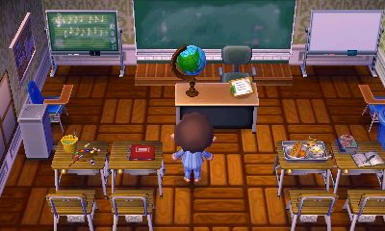
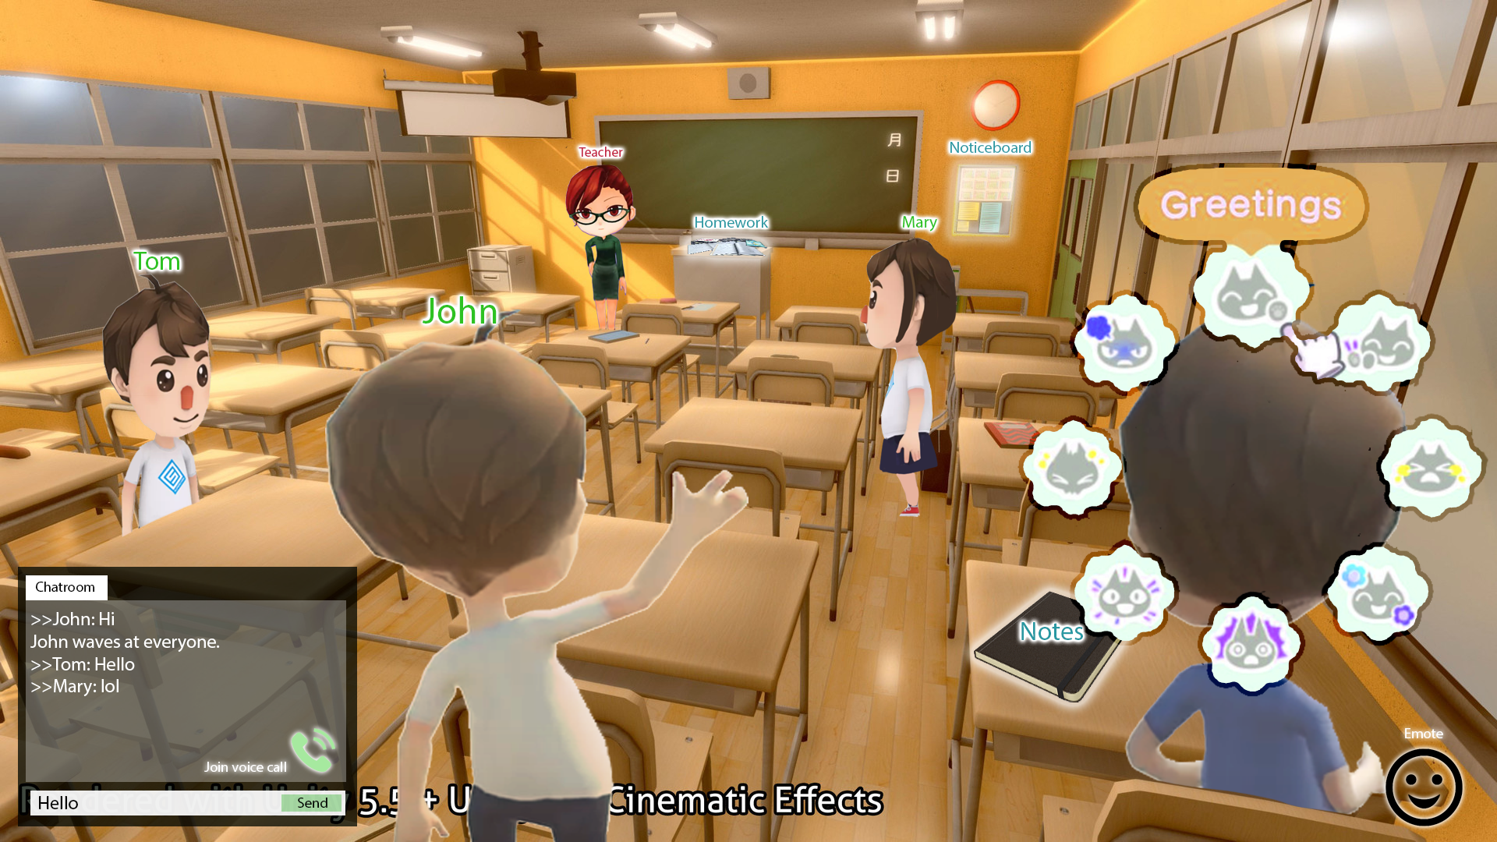
Visual Representation

Slide 4
Features
Students have customizable avatars to interact with each other/ teachers - avatars can do emotes (e.g. raise their hand when they want to ask a question)
3D model of a classroom
Interactive, students can make their character sit down
interact with the classroom environment (e.g. pick up paper to look at the notes/ worksheets)
There will be a virtual classroom projector at the front, where the lecturer can conduct a video call/ share their screen. When the teacher is presenting, all students will be forced to sit down.
Includes voice call and text chat features
For tutor: toggle between classroom view and slide sharing view
In-game currency - tutors can reward students who answer questions
Students can use the virtual currency to buy virtual items (e.g. laptops, more customization options for their avatar)

Slide 5
Environment
3D classroom
Tutor
Students

Slide 6
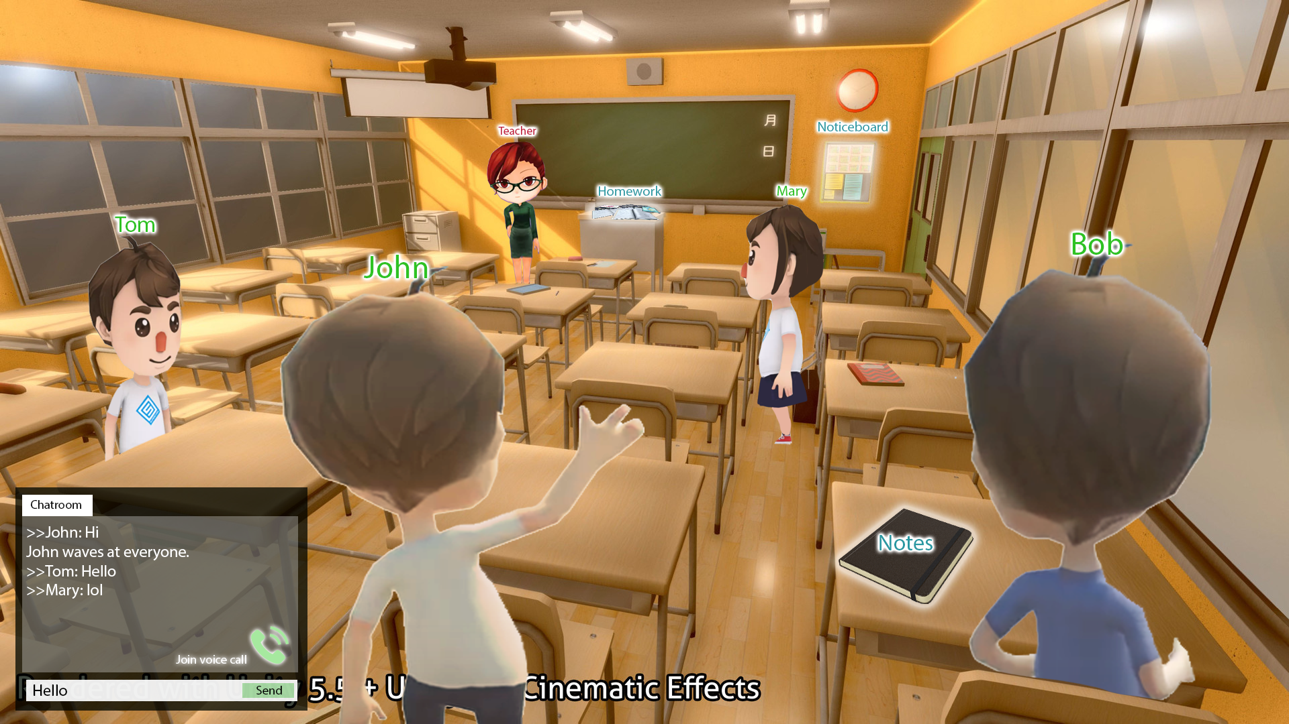
3D Classroom elements
Projector Screen - share screen
Whiteboard - Interactive screen for all to write on
In-game Timer
Access to course resources
Interactable objects (e.g. notebook)

Slide 7
Voice / Video
Classroom Host - usually Tutor - able to restrict rights Eg. Turn students voice on/off
Raise hand to request to speak
Tutor’s View Able to toggle between student’s view (slides) and tutor’s view (looking students)
Student’s View Full slides view (only slides) and Classroom view (smaller slides+class)

Slide 8
Fun Elements
It’s CUTE
Interact with friends through gestures Eg. Greet, Hi-five, Laugh, Pay respects, Give flowers
Virtually meeting your friends through the pandemic lol
Less boring

Slide 9
Possible Solutions

Slide 10
Possible Solutions
Unity
Pros:
Game, it’s fun :D
Cons:
Need to retrieve information
Not sure if it supports voice, video, chat, screen sharing
Security Issues
Help guys :”)

